Slide 1
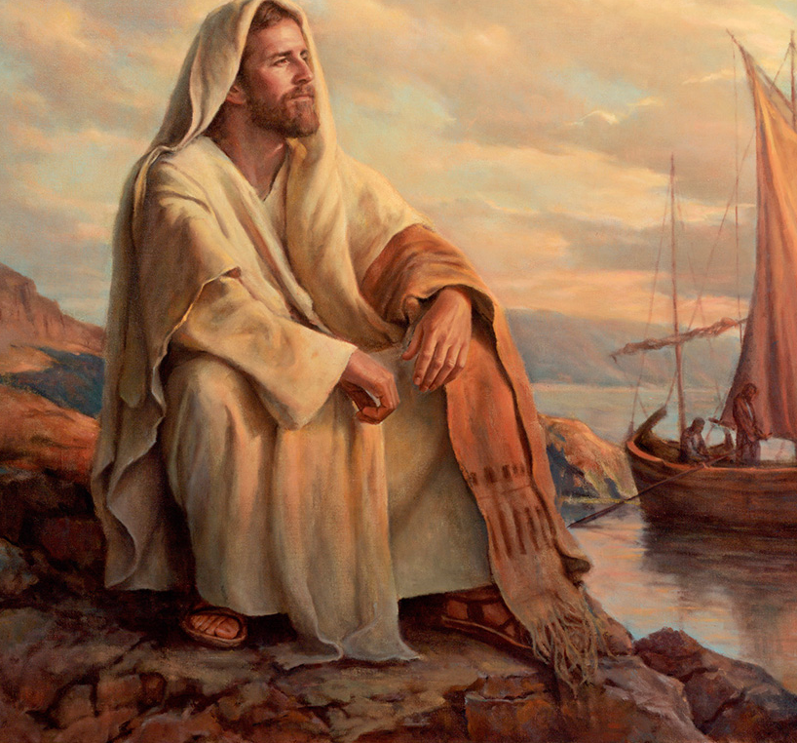
The Life of Christ

Slide 2

Seven Periods of Jesus’ Life
Years of Preparation
Beginning of Ministry
Great Galilean Ministry
Periods of Retirement
Close of Ministry
Last Week
Resurrection and Exaltation

Slide 3
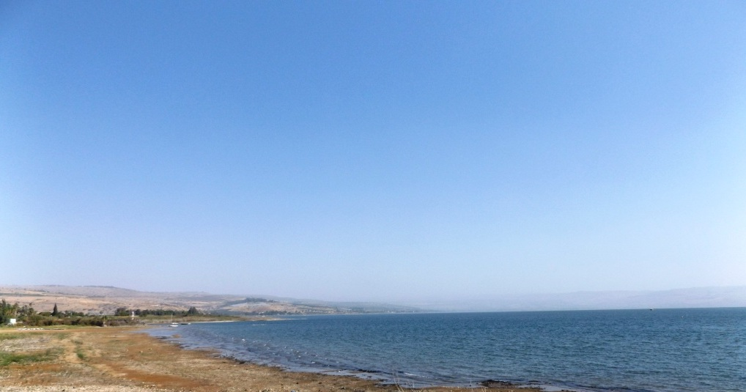
“On the same day, when evening had come, He said to them, ‘Let us cross over to the other side.’ Now when they had left the multitude, they took Him along in the boat as He was. And other little boats were also with Him.” (Mark 4:35-36)

Slide 4
Jesus stills the Storm (Mark 4:35-41; Matthew 8:18, 23-27; Luke 8:22-25)
After teaching parables to the multitudes, Jesus and His disciples got in a boat to journey to the other side. “But as they sailed He fell asleep. And a windstorm came down on the lake, and they were filling with water, and were in jeopardy” (Luke 8:23; cf. Matthew 8:24).
The disciples wake Jesus saying, “Master, we are perishing!”
Jesus arises and rebukes the wind and water saying “Peace, be still,” and there was a calm.
Jesus asks His disciples, “Where is your faith?” The disciples marvel and fear and ask themselves, “Who can this be?” – even the winds and water obey him (Luke 8:25).
Notes:
Mark 4:38-41 But He was in the stern, asleep on a pillow. And they awoke Him and said to Him, "Teacher, do You not care that we are perishing?" 39 Then He arose and rebuked the wind, and said to the sea, "Peace, be still!" And the wind ceased and there was a great calm. 40 But He said to them, "Why are you so fearful? How is it that you have no faith?" 41 And they feared exceedingly, and said to one another, "Who can this be, that even the wind and the sea obey Him!"

Slide 5
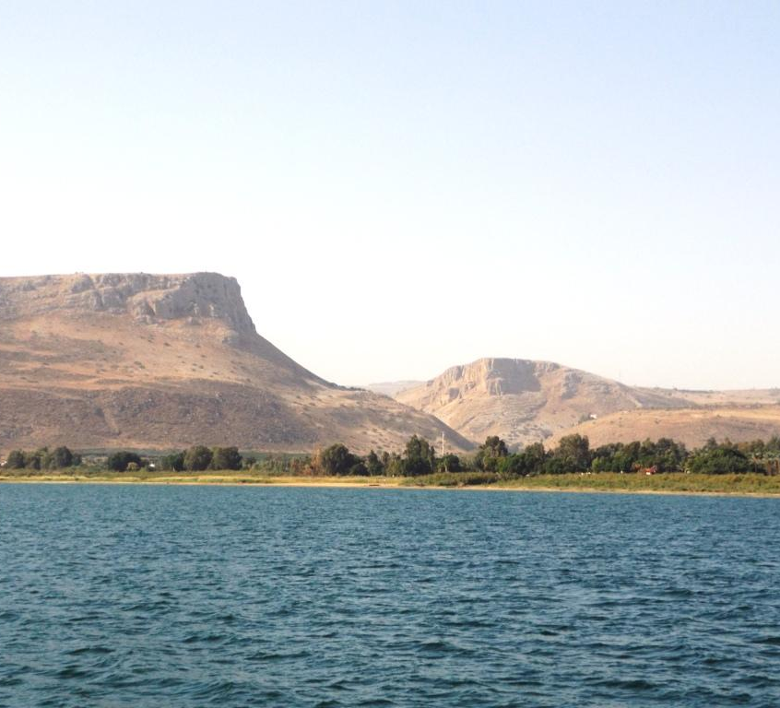
The Sea of Galilee is a pear-shaped lake, with a length from north to south of 13 miles, a maximum width of 8 miles, and a maximum depth of 157 feet. The lake lies 686 feet below sea level, but it is surrounded by steep cliffs and hills, creating swirling wind currents which foster severe storms. Mount Arbel is 594 feet ABOVE sea level.

Slide 6
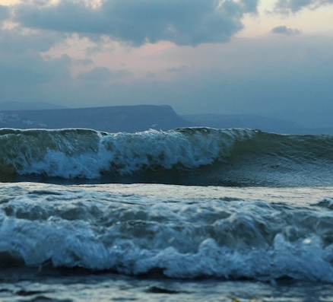
Waves Crashing on the Shore of the Sea of Galilee
Courtesy of the Pictorial Library of Bible Lands

Slide 7
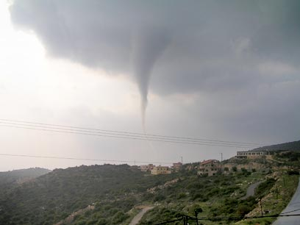
The storm pictured to the right occurred in Galilee in April of 2006. One resident said, “Believe me, it was like a Tsunami. I thought Hurricane Katrina came to Israel” -- Israel News 04.05.06

Slide 8
Jesus Heals the Gerasene Demoniac (Mark 5:1-20; Matthew 8:28-34; Luke 8:26-39)
Jesus and his disciples disembark in an area inhabited by the Gerasenes (var. Gadarenes or Gergesenes).
They meet a man coming out of the tombs who had an unclean spirit (Mark 5:2-5).
The man’s behavior is as follows:
He had his dwelling among the tombs.
No one could bind him, not even with chains (he would pull apart the chains and break the shackles).
No one could tame him.
Night and day, he was in the mountains and in the tombs, crying out and cutting himself with stones.

Slide 9
Jesus Heals the Gerasene Demoniac (Mark 5:1-20; Matthew 8:28-34; Luke 8:26-39)
Jesus casts out the demon (Mark 5:6-13)
The man runs and worships Jesus.
He addresses Him as “Jesus, Son of the Most High God.”
The demon is called “Legion” because there were many.
When Jesus commands the unclean spirit to come out of the man, he begs Jesus not to torment him or send him out of the country or cast him into the abyss* (Luke 8:31).
Jesus permits the demons to enter some swine, and the herd of 2,000 runs down a steep embankment into the sea and drowns.
NOTE: Jesus’ power over demons proves His identity as God’s Son and is connected to His power to forgive sins (Matthew 12:28-29; Zechariah 13:1-2).
Notes:
Abyss is from ἄβυσσος and is translated “bottomless pit” 7 times in the book of Revelation where it seems to refer to an unpleasant place of confinement a and/or punishment for demons and evil beings.
Rev_9:1-2,11 Then the fifth angel sounded: And I saw a star fallen from heaven to the earth. To him was given the key to the bottomless pit. 2 And he opened the bottomless pit, and smoke arose out of the pit like the smoke of a great furnace. So the sun and the air were darkened because of the smoke of the pit. 11 And they had as king over them the angel of the bottomless pit, whose name in Hebrew is Abaddon,
Satan himself is cast there in Rev_20:1-3 Then I saw an angel coming down from heaven, having the key to the bottomless pit and a great chain in his hand…3 and he cast him into the bottomless pit, and shut him up, and set a seal on him, so that he should deceive the nations no more till the thousand years were finished. But after these things he must be released for a little while.
Matthew 12:29 Or how can one enter a strong man's house and plunder his goods, unless he first binds the strong man? And then he will plunder his house.
Zechariah 13:1-2 "In that day a fountain shall be opened for the house of David and for the inhabitants of Jerusalem, for sin and for uncleanness. 2 "It shall be in that day," says the LORD of hosts, "that I will cut off the names of the idols from the land, and they shall no longer be remembered. I will also cause the prophets and the unclean spirit to depart from the land.

Slide 10
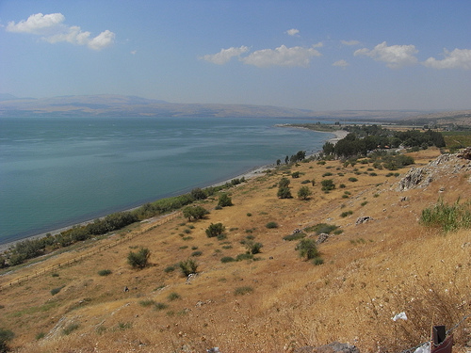
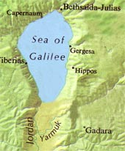
A steep slope descending to the east side of the Sea of Galilee – near Gergesa, modern Kersa

Slide 11
Jesus Heals the Gerasene Demoniac (Mark 5:1-20; Matthew 8:28-34; Luke 8:26-39)
The swine herders [probably Gentiles] flee and tell of the event in the city and in the country (Mark 5:14).
The people of the region come to the location and see Jesus and the man who had been demon possessed, now clothed and in his right mind (Mark 5:15-16).
They plead with Jesus to depart from their region (Mark 5:17)
The man whom Jesus healed asks to accompany Jesus, but Jesus commands him to go home and tell his friends and neighbors what great things the Lord had done for him (Mark 15:18-19).
The man departs and proclaims his story in the Decapolis, “and all marveled” (Mark 5:20).

Slide 12
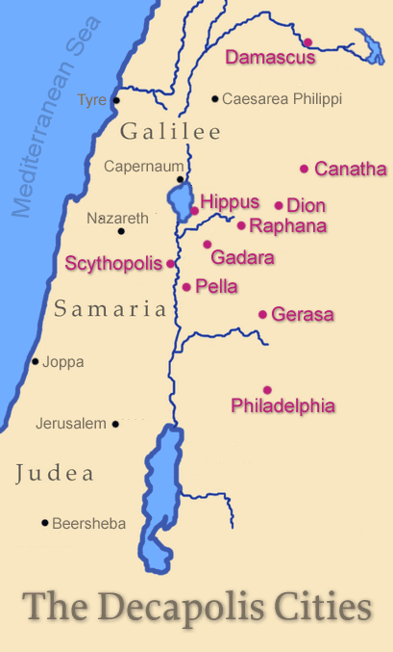
The Decapolis “(Greek: deka, ten; polis, city) was a group of ten cities on the eastern frontier of the Roman Empire in Judea and Syria. The ten cities were not an official league or political unit, but they were grouped together because of their language, culture, location, and political status. The Decapolis cities were centers of Greek and Roman culture in a region that was otherwise [Jewish]” – Wikipedia
Mark is the only gospel writer to mention this region by name (4:25; 5:20; 7:31).

Slide 13
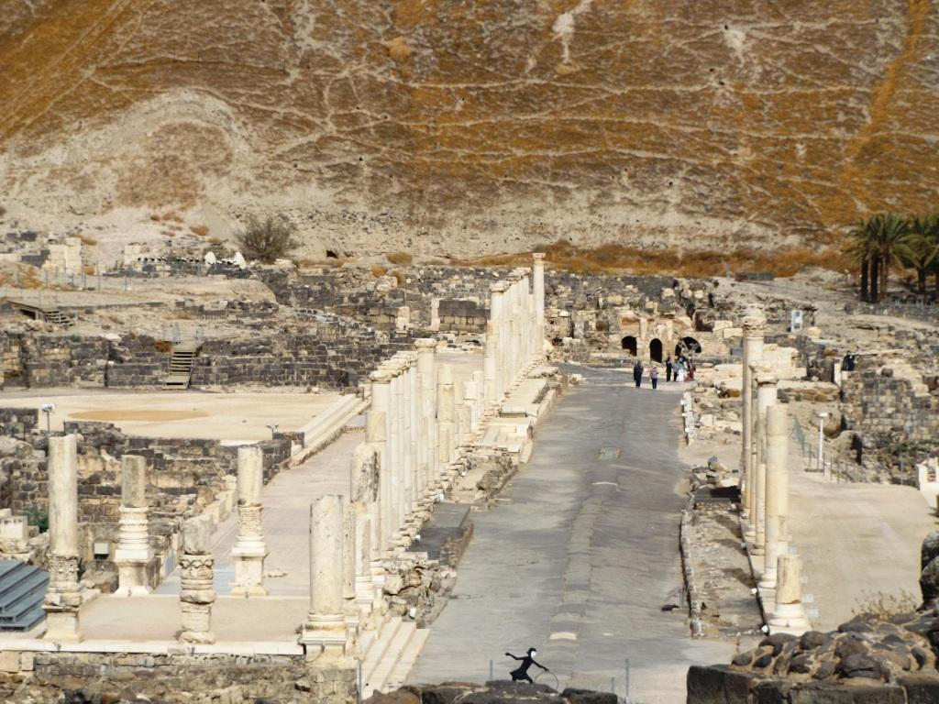
Ruins of Scythopolis

Slide 14
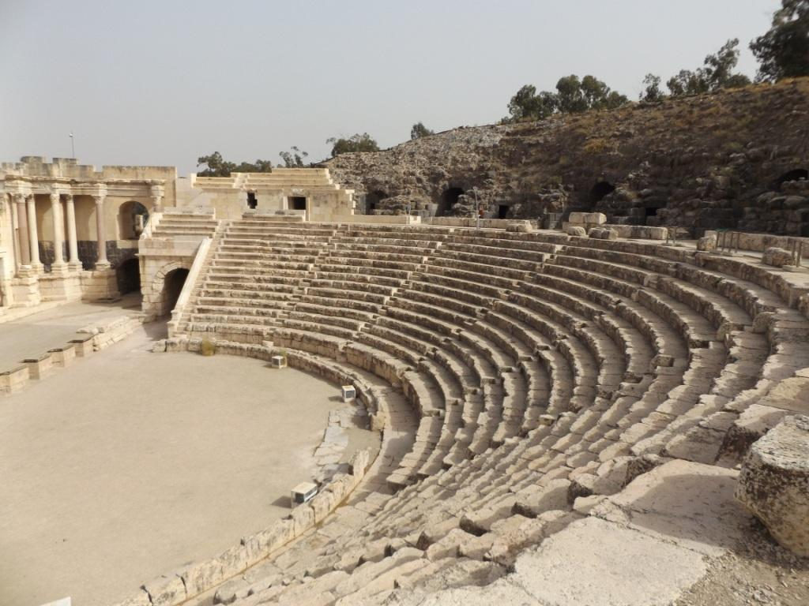
Theater at Scythopolis

Slide 15
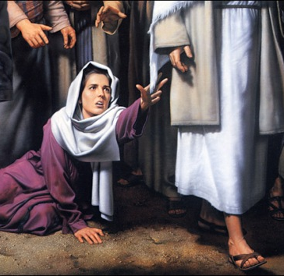
Jairus’ daughter & the woman with the issue of blood (Mark 5:21-43; Matthew 9:18-26; Luke 8:40-56)
Jairus, a ruler of the synagogue, asks Jesus to come heal his daughter who is near death.
As Jesus is going, a woman in the crowd who had suffered with an issue of blood for 12 years touches His garment believing she could be healed
She is unclean (Leviticus 15:25-26)*
She had suffered & spent much seeking healing.
She is healed when she touches Jesus.
Knowing power had gone out of Him, Jesus asks, “Who touched my clothes?”
The woman falls down before Jesus and explains what she has done.
Jesus said, “Your faith has made you well!”
Notes:
*Leviticus 15:25-26 If a woman has a discharge of blood for many days, other than at the time of her customary impurity, or if it runs beyond her usual time of impurity, all the days of her unclean discharge shall be as the days of her customary impurity. She shall be unclean. Every bed on which she lies all the days of her discharge shall be to her as the bed of her impurity; and whatever she sits on shall be unclean, as the uncleanness of her impurity.

Slide 16
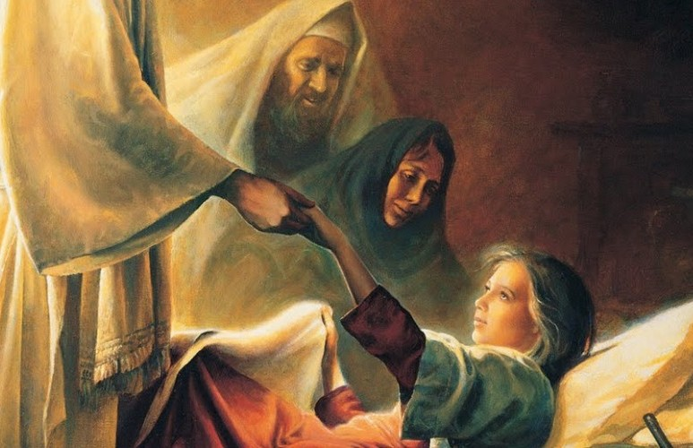
The Raising of Jairus’ Daughter (Mark 5:21-43; Matt. 9:18-26; Luke 8:40-56)
While Jesus is still speaking, people come from the ruler’s house to tell him that his daughter had died.
They ask, “Why trouble the teacher any further?”
Jesus tells Jairus, "Do not be afraid; only believe.”
Jesus allows only Peter, James, and John to enter the house with Him.
Jesus proclaims, “The child is not dead but sleeping.”
Jesus takes the child by the hand and says, "Little girl, I say to you, arise."
Immediately the girl arose and walked.
She was 12 years old.
Jesus commands them not to tell others about the miracle.

Slide 17
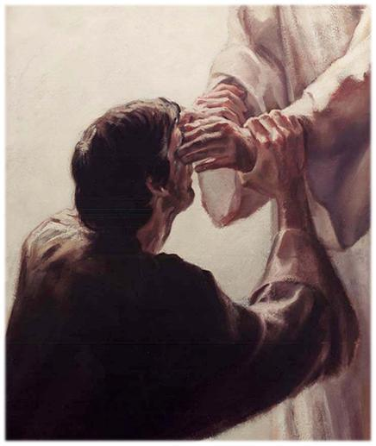
Jesus heals 2 blind men (Matthew 9:27-34)
Two blind men follow Jesus crying out, “Son of David, have mercy on us!”
Jesus ask, “Do you believe that I am able to do this?
When they say “yes,” Jesus touches their eyes and says, "According to your faith let it be to you."
He tells them to “See that no one knows it,” but they spread the news.

